Slide 1

Working With Data DATA9910
Week 1
Lucas Rizzo
email: lucas.rizzo@tudublin.ie

Slide 2
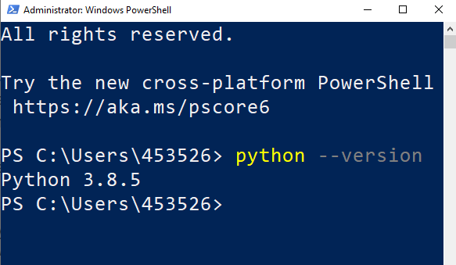
Installing Python
There are lots of ways to install Python. I recommend the official installer or Anaconda.
If you already have Python installed check your version by opening a terminal and running
>>python --version
It should show something starting with 3

Slide 3
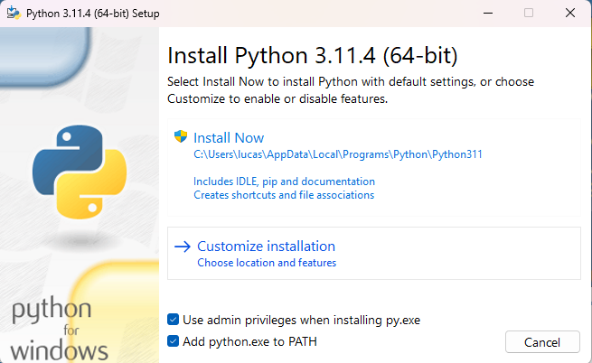
Installing on Windows
Download Python from https://www.python.org/downloads
Make sure you check the option to Add Python to your PATH
Once the installation is complete, open up a terminal and check your version as shown previously

Slide 4
Installing on Mac / Ubuntu
Newer versions of MacOS ship with Python 3 by default
If you’re running MacOS and don’t have python head to the downloads page on the official website to install it
https://www.python.org/downloads/
Python 3 can be installed on Ubuntu using apt
>>sudo apt install python3.11

Slide 5
PIP
PIP is a package manager for Python packages, or modules if you like.
If you have Python version 3.4 or later, PIP is included by default.
A package contains all the files you need for a module.
Modules are Python code libraries you can include in your project.
Check if PIP is Installed
>>pip --version
If you don’t have it, follow this guide https://pip.pypa.io/en/stable/installation/
To install a Python package open a terminal and run
>>pip install <package name>
For example, to install numpy you would run
>>pip install numpy
More info commands using PIP here
https://www.w3schools.com/python/python_pip.asp

Slide 6
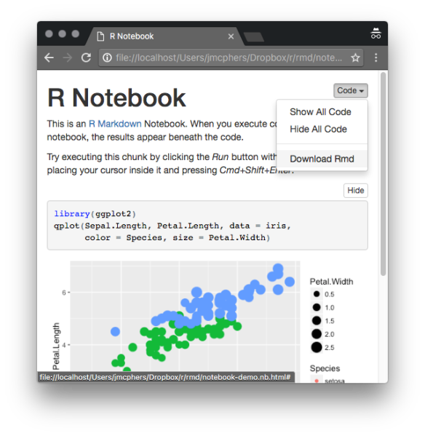
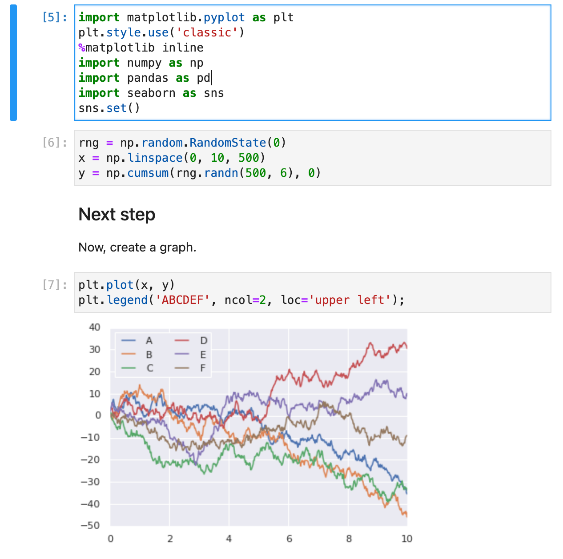
Notebooks
Notebooks are interactive documents that allow you to combine code, text, and multimedia elements into a single file.
It makes commenting your code much easier and allows you to interactively edit the code and run it from your web browser (if you want)
In this course we will be using them for basically everything (studying, assignments, labs, etc.)
We will be using two types of notebooks:
Jupyter Notebooks (.ipynb file extensions) that can handle Python and R kernels.
R Markdown notebooks (.rmd file extension) that can only handle R kernel.

Slide 7
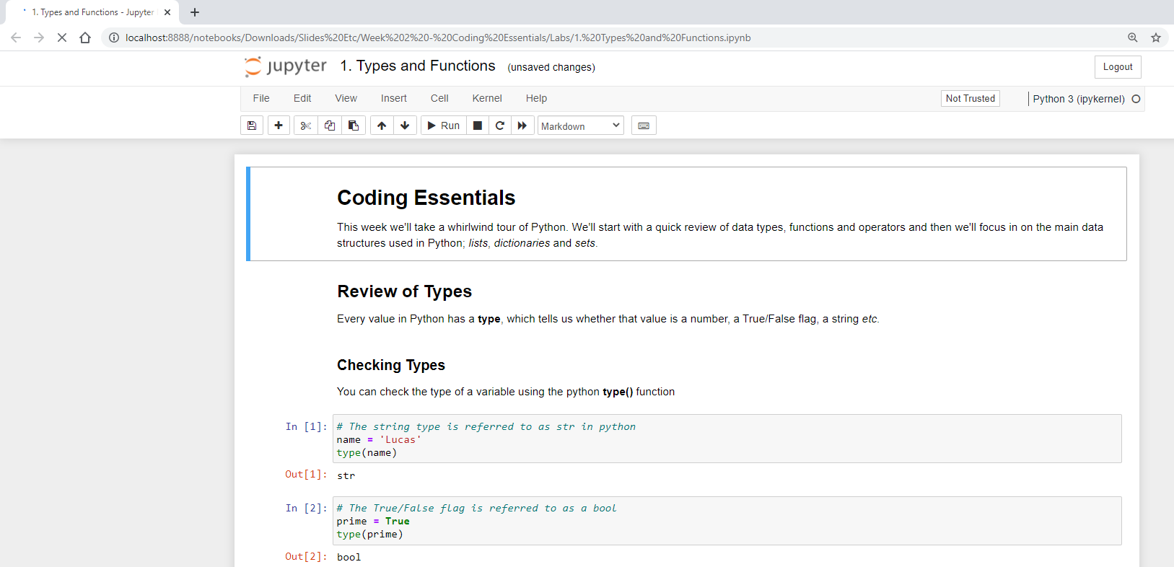
Installing Jupyter
Jupyter Notebook is a software that lets you combine text markdown with Python/R code

Slide 8
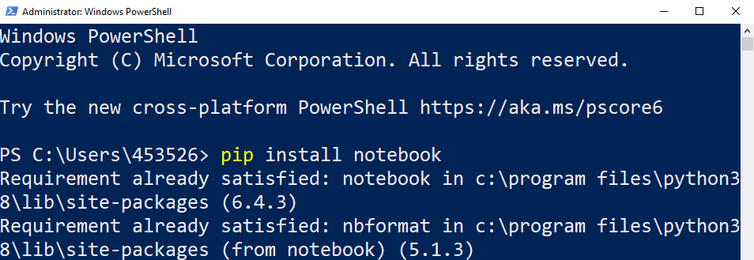
Installing Jupyter
You can install Jupyter using pip (but the module is actually called notebook)

Slide 9

Installing Jupyter with Anaconda
You can use Anaconda to help you manage Python open-source packages.
Anaconda is a Python/R data science distribution that contains conda, a package and environment manager, which helps you manage open-source packages available to them.
It is good if you want to manage several Python/R environments, with different versions and packages. It also gives you a better interface to handle your packages.
The main issues are that it can be very slow when updating and installing packages and R packages might be harder to find.

Slide 10
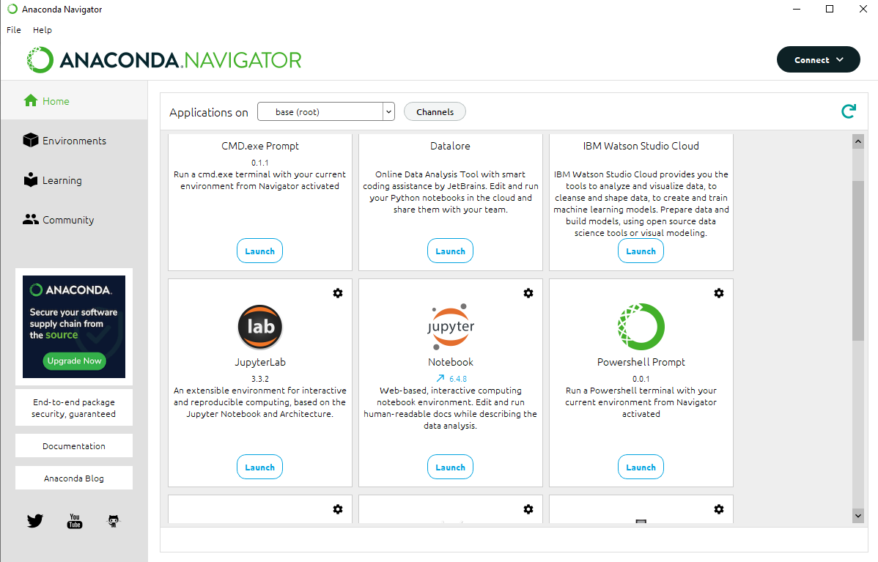
Anaconda

Slide 11
Anaconda
Detailed instructions, including other operating systems, can be found here (it should be easy).
You can check Anaconda starter guide
Conda cheat sheet

Slide 12
Using Jupyter Notebook (from command line)
To start jupyter open a terminal and switch to the directory containing your code and run the notebook command
For example, if your code is in a folder called Python in your home directory
>> cd Python
>> jupyter notebook
OR >> python -m notebook
A browser should open automatically but if not copy and paste the link shown in the terminal
When you’re finished, you can stop jupyter by pressing control + c
If you need to install a package using pip you may need to stop and restart the jupyter notebook for the changes to come through

Slide 13
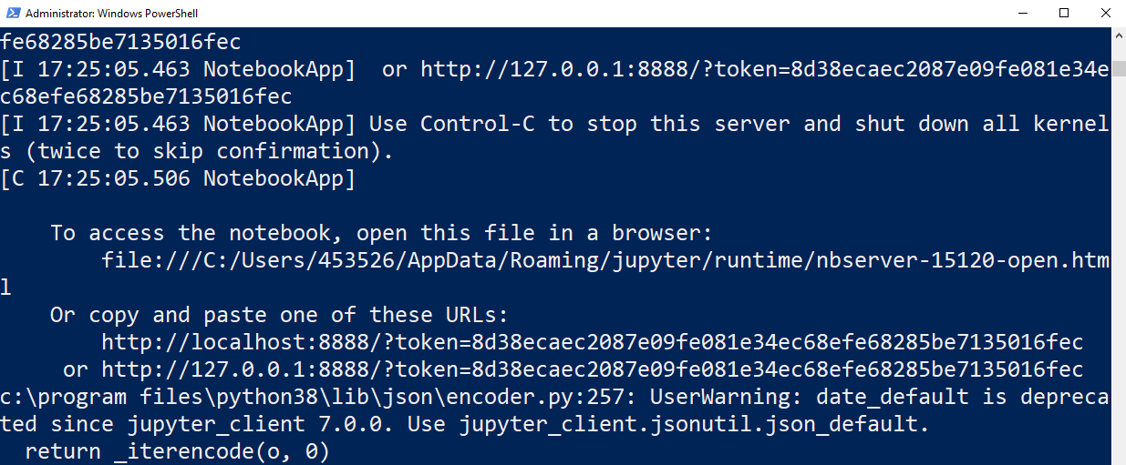
Starting Jupyter Notebook (from command line)
If a browser doesn’t automatically open, copy and paste one of the URLs highlighted

Slide 14
Starting Jupyter Notebook (with Anaconda)

Slide 15
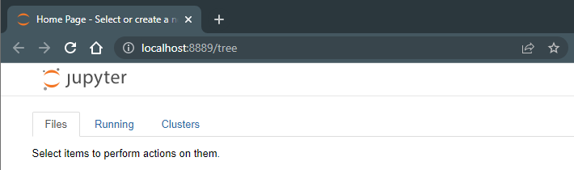
Starting Jupyter Notebook
You should have something like that in the browser

Slide 16
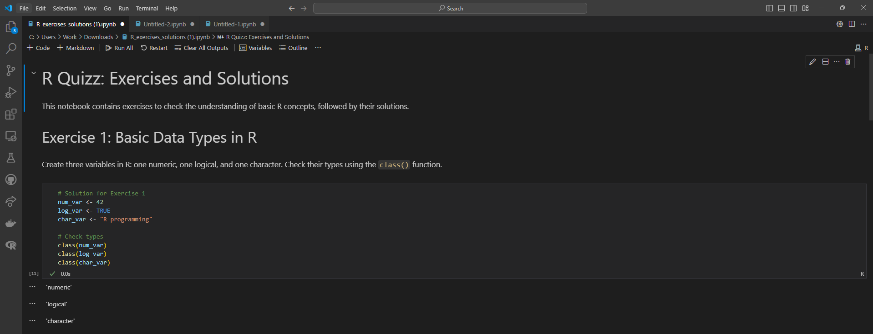
VSCode
VSCode can also handle .ipynb files
If you want to use it follow the tutorial here to start working with notebooks.

Slide 17
Markdown Cells
Jupyter notebooks consist of blocks of code (called cells). Each cell can be either code or markdown (dropdown at the top of the screen)
Jupyter uses GitHub markdown for the text cells.
Markdown is a simple text-based formatting system
For a full list of markdown commands see this web-page
When you edit a cell you will see the markdown source code, run the cell to see the formatted output

Slide 18
Code cells
Code cells let you run Python/R code (depending on the chosen kernel) and show you the output directly underneath
Variables can be shared between cells (provided you run them in the correct order).
Before submitting a notebook select the option to restart kernel and run all cells to make sure it will work for another user running your notebook (when you’re working ad-hoc it’s easy to get the order wrong)

Slide 19
Submitting Notebooks
Make sure you run your code before saving your notebook for submission
If you’re using external files, include them in the notebook folder and use a relative path, for example
> I = cv2.imread(‘image.jpg’) Not > I = cv2.imread(‘C:\Users\453526\Python\image.jpg’)
When you’re finished, save the notebook, and zip the entire folder including any external files you used
Your instructor should be able to restart kernel and run all cells without making any edits

Slide 20
Downloading and Installing R (from scratch)
R is another base language you’ll be using.
It is “a free software environment for statistical computing and graphics”. By itself, R is just a programme which will read in and execute a script.
Open an internet browser and go to www.r-project.org
Click the "download R" link in the middle of the page under "Getting Started."
Select a CRAN location (a mirror site) and click the corresponding link.
Click on the "Download R for Windows" link at the top of the page.
Click on the "install R for the first time" link at the top of the page.
Click "Download R for Windows" and save the executable file somewhere on your computer. Run the .exe file and follow the installation instructions.
Now that R is installed, you need to download and install RStudio.

Slide 21
RStudio (from scratch)
RStudio is a very nice Integrated Development Environment (IDE) which makes writing R programmes a joy. This isn’t necessary but highly recommended!
Go to https://posit.co/download/rstudio-desktop/ and click on the "Download RStudio" button.
Click on "Download RStudio Desktop."
Click on the version recommended for your system, or the latest Windows version, and save the executable file. Run the .exe file and follow the installation instructions.

Slide 22
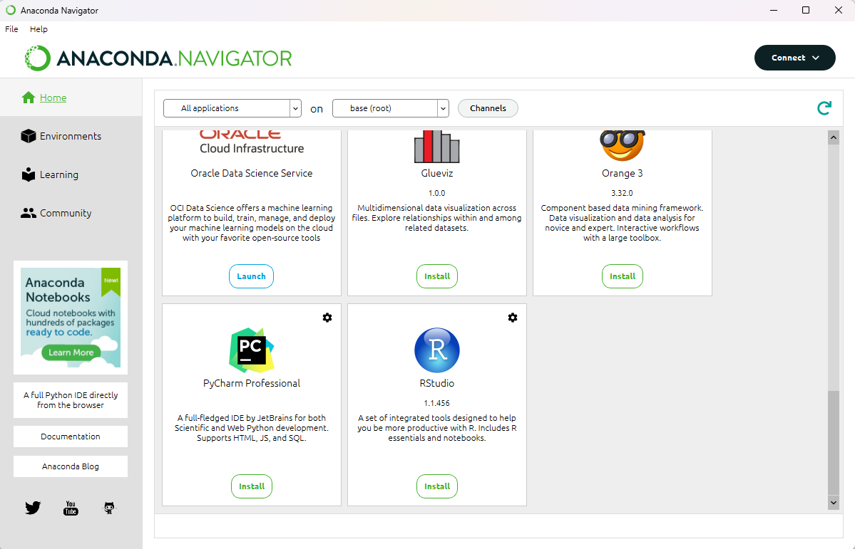
R and RStudio (Anaconda)

Slide 23
RStudio example
Download the file “Titanic Exploration.Rmd” in Brightspace and open it with RStudio.
Rmd is an extension for R Markdown file.
It contains YAML (yet another markup language) metadata, Markdown-formatted plain text, and chunks of R code that, when rendered using RStudio, combine to form a sophisticated data analysis document.

Slide 24
Lab
This week you will go through the same Titanic Exploration example but using Python and Jupyter Notebook instead.
Download the file “Titanic Exploration.ipynb” in Brightspace and make sure you can run the code in it.
Check the difference in syntax between Python and R and see what you prefer. Observe the differences between methods and data types to achieve the same results.
You won’t understand all the details. This is just to give an overview of how and what you can do with both languages.

Slide 25
Questions?

